Slide 1
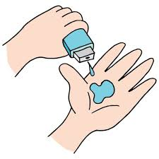
Doctor Visits Analysis
[Deeraj Natarajan],
AICTE NUMBER: APPLY_172728633766f44c41d8adc
College Name : SRM University of Science and Technology
Department Name, Branch.: Data Science MTECH DATA SCIENCE

Slide 2

PROBLEM STATEMENT
The healthcare sector faces challenges in understanding patient visit patterns, demographics, and health conditions. Analyzing data on doctor visits can reveal insights into patient behavior, healthcare accessibility, and the impact of socio-economic factors on health outcomes. This project aims to leverage data analytics to identify trends and correlations in doctor visits, ultimately improving healthcare delivery and resource allocation.

Slide 3
Project Description This project involves analyzing a dataset of doctor visits to uncover patterns related to patient demographics, health conditions, and visit frequency. By employing statistical analysis and visualization techniques, we aim to provide actionable insights that can inform healthcare providers and policymakers. The analysis will focus on various factors such as age, gender, income, and chronic illnesses, enabling a comprehensive understanding of patient needs and healthcare utilization.

Slide 4

WHO ARE THE END USERS?
The end users of this project include healthcare providers, policymakers, and researchers. Healthcare providers can utilize the insights to enhance patient care and optimize resource allocation. Policymakers can leverage the findings to inform health policies and improve healthcare access. Researchers can use the data to explore further studies on health trends and socio-economic impacts on healthcare. Ultimately, the analysis aims to benefit the entire healthcare ecosystem.

Slide 5

Technology Used
The project employs various technologies, including Python for data analysis and manipulation, utilizing libraries such as Pandas and NumPy. Data visualization is achieved through Matplotlib and Seaborn, enabling clear representation of findings. Additionally, Jupyter Notebooks are used for interactive analysis and documentation. The project may also incorporate machine learning techniques for predictive analytics, enhancing the depth of insights derived from the dataset.

Slide 6
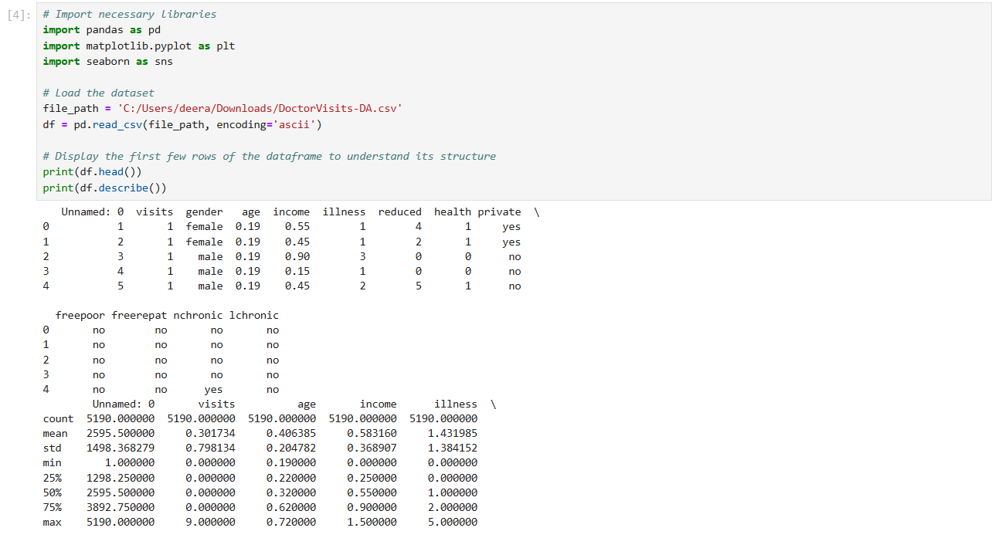
RESULTS
[Add screen shots of your code ]
Demo link:
https://colab.research.google.com/drive/1eC_x6Irp9NjSH6e8qoM47YFwtpdiMYSc?usp=sharing

Slide 7
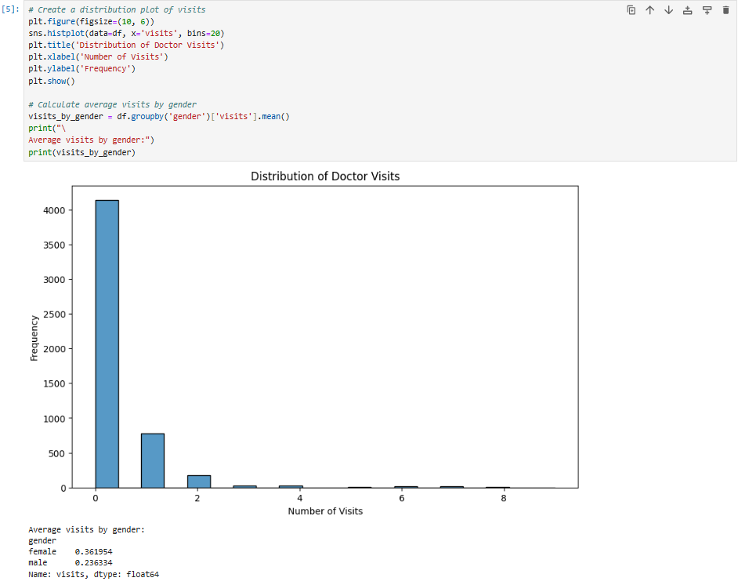
RESULTS
[Add screen shots of your code ]
Demo link:
https://colab.research.google.com/drive/1eC_x6Irp9NjSH6e8qoM47YFwtpdiMYSc?usp=sharing

Slide 8
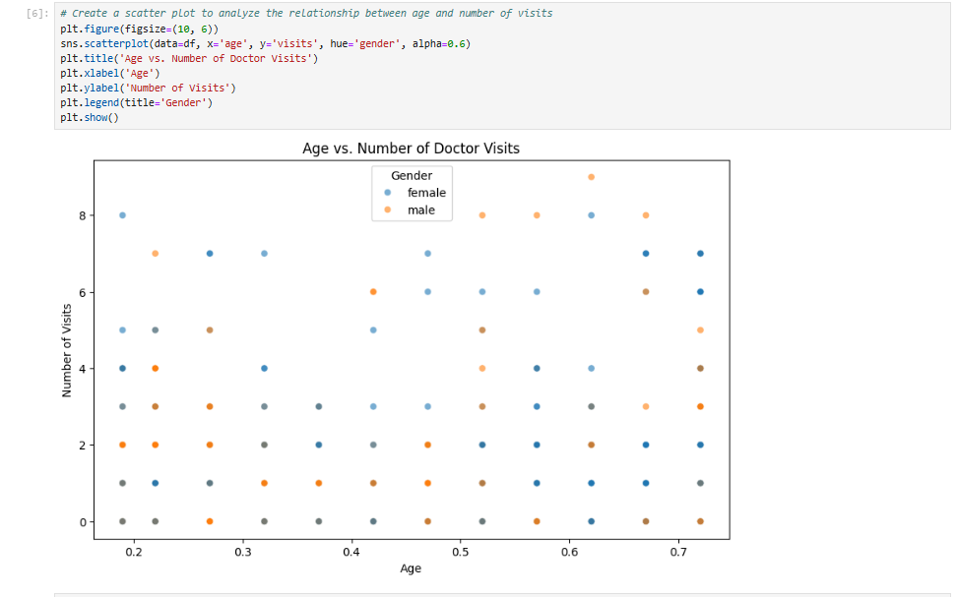
RESULTS
[Add screen shots of your code ]
Demo link:
https://colab.research.google.com/drive/1eC_x6Irp9NjSH6e8qoM47YFwtpdiMYSc?usp=sharing

Slide 9
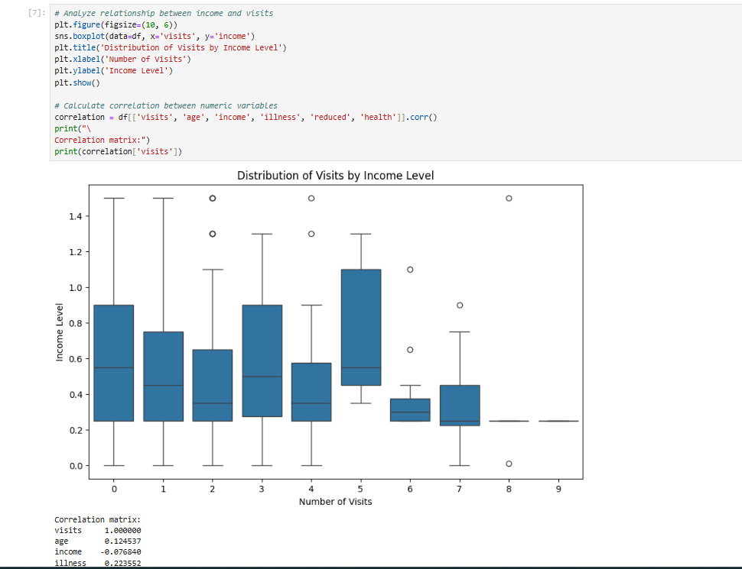
RESULTS
[Add screen shots of your code ]
Demo link:
https://colab.research.google.com/drive/1eC_x6Irp9NjSH6e8qoM47YFwtpdiMYSc?usp=sharing

Slide 10
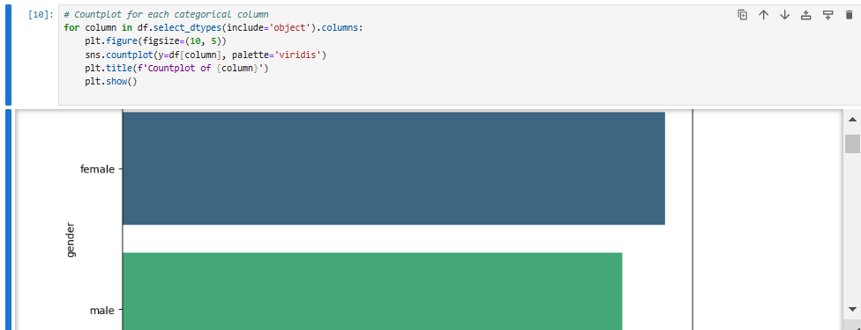
RESULTS
[Add screen shots of your code ]
Demo link:
https://colab.research.google.com/drive/1eC_x6Irp9NjSH6e8qoM47YFwtpdiMYSc?usp=sharing

Slide 11
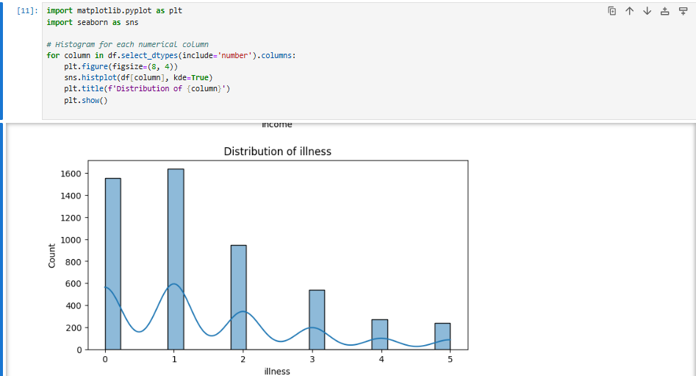
RESULTS
[Add screen shots of your code ]
Demo link:
https://colab.research.google.com/drive/1eC_x6Irp9NjSH6e8qoM47YFwtpdiMYSc?usp=sharing

Slide 12
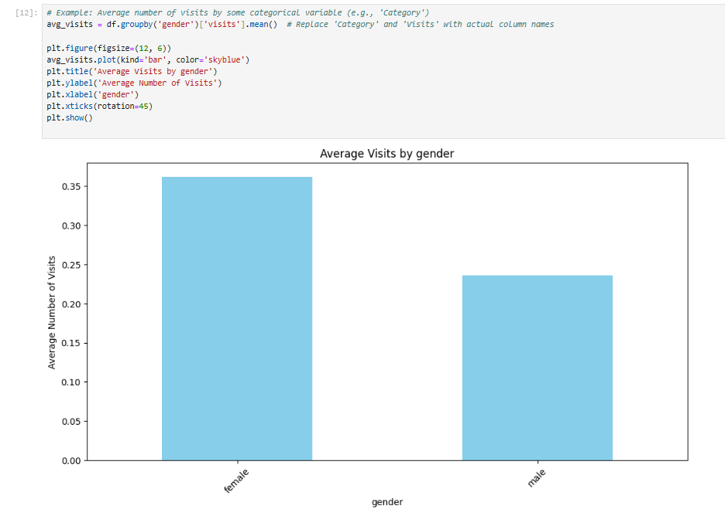
RESULTS
[Add screen shots of your code ]
Demo link:
https://colab.research.google.com/drive/1eC_x6Irp9NjSH6e8qoM47YFwtpdiMYSc?usp=sharing

Slide 13
Thank you
DEERAJ NATARAJAN
.
.

